Slide 1
Business Sales Insight
by
Raj Praveen Pradhan

Slide 2
Business Understanding
AltiQ which is a Delhi based computer hardware manufacturing company, have suffered a decline in sales which has reduced company’s profit. So, to achieve its next quarter profit target the Sales Director have appointed you to build a dashboard which provides business insight and reduce manual time involved in data engineering to maximize company profit.

Slide 3
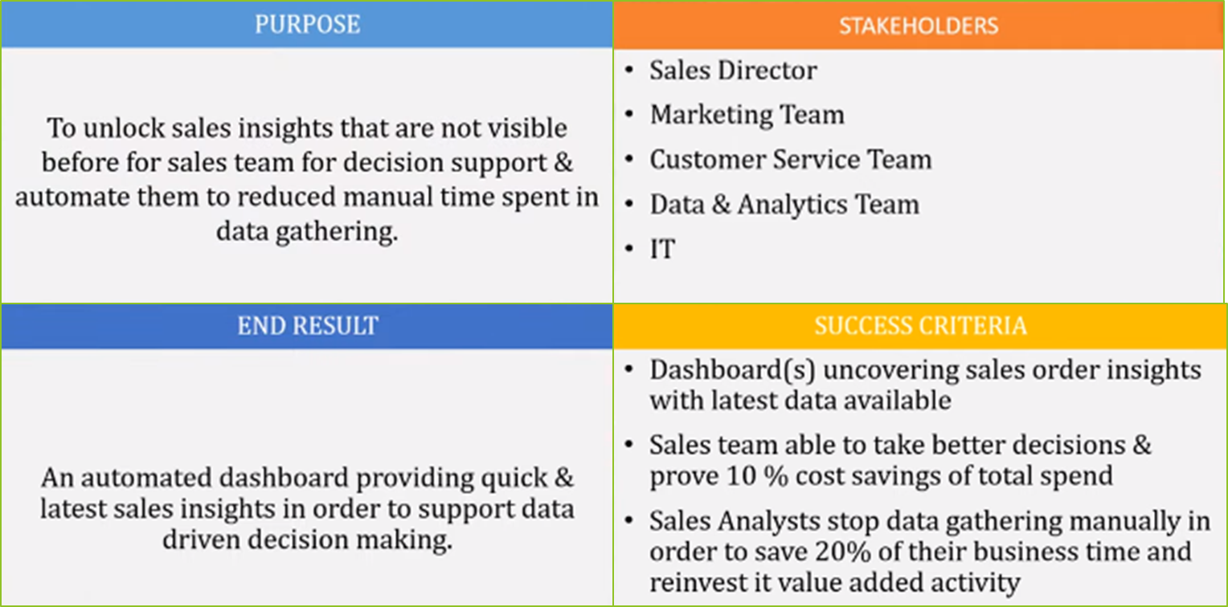
AIMS Grid

Slide 4
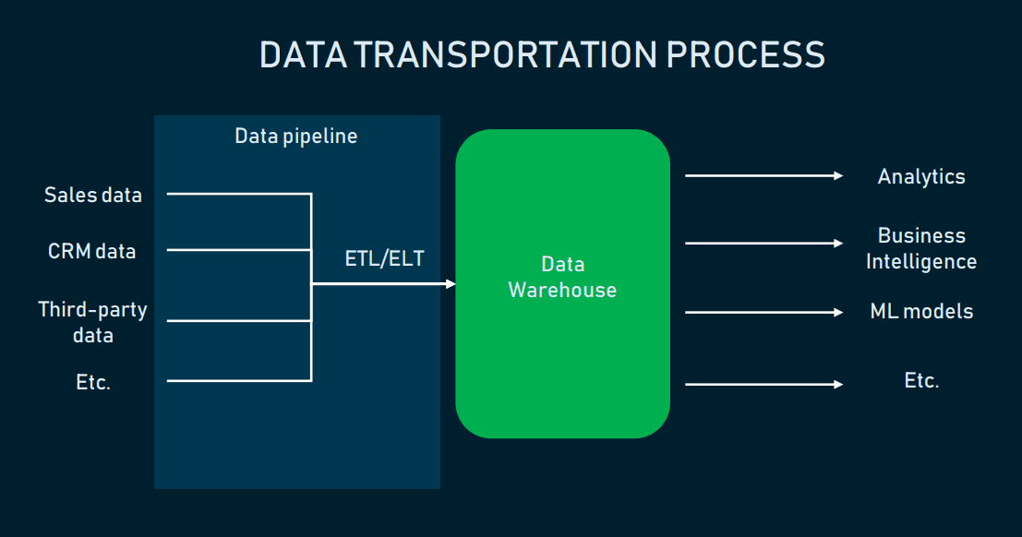
Data Engineering Cycle
Notes:
src: https://www.altexsoft.com/blog/datascience/what-is-data-engineering-explaining-data-pipeline-data-warehouse-and-data-engineer-role/

Slide 5
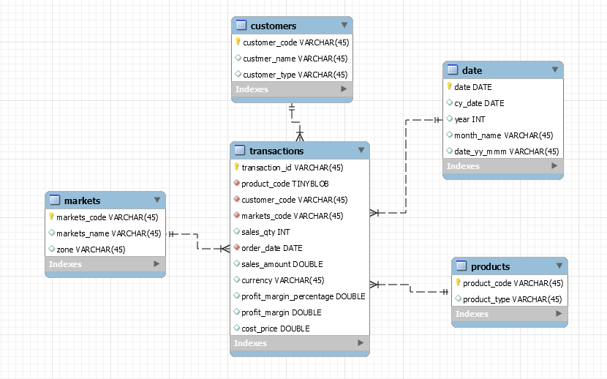
Database Schema

Slide 6


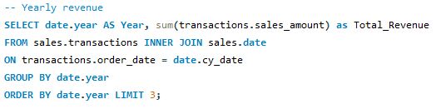

Analyzing Data using MySQL
Few transactions were made in USD, which need to be converted to INR.
For confirmation checking whether there was a decline in revenue, which is seems to be true.

Slide 7
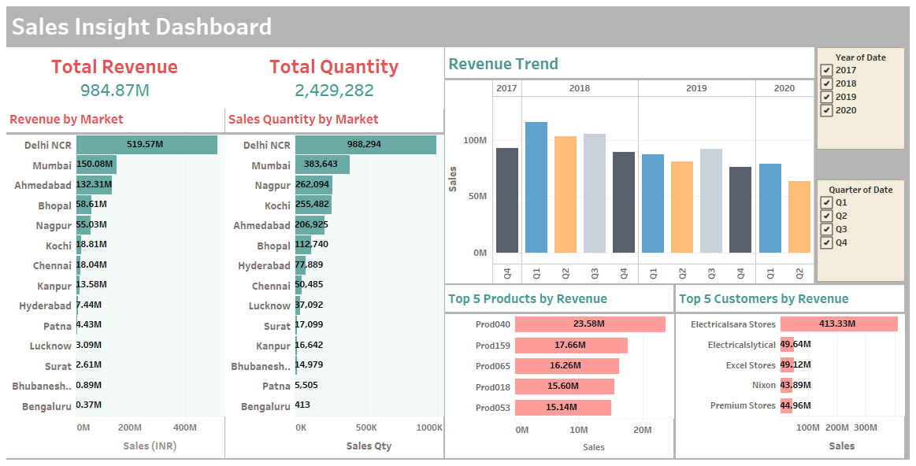
Visualizing Data using Tableau

